Slide 1
Systematic review on cancer screening models.
AddNode(t,basenode,graph)
AddNode(t,basenode,graph)
Alexander Bespalov, PhD Student,
University of Tampere

Slide 2
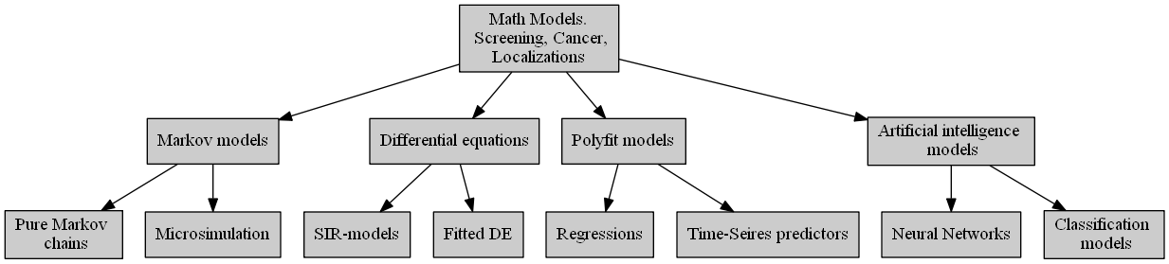
Models for analysis

Slide 3
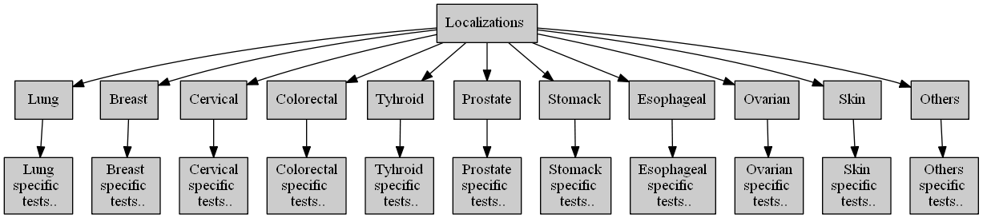
Localization plan

Slide 4
Papers filter pattern(Search strategy)
Screening AND
(Model OR Simulation) AND
Cancer OR
<Localization name> OR
<Model class name>

Slide 5
Checklist for paper
1. Motivation for new model
2. General modelling approach
3. Model own specific features
4. Validation type
5. Screening approach
6. Connection with other models

Slide 6
Evaluation criteria groups
Basic model information
Demands information
Models connections information
Models assessments
SPIN

Slide 7
Evaluation criteria(Table fields)
Region
Model “family”
Cancer Localization
Model accessibility(opensource)
Model implementation language
Demand for this model
Natural history specific features
Screening features
Treatment features
Other features
Model drawbacks
Was in practical use?
Integral usefulness coef.
Outer citations count
Citation trend coefficient
“Mainstreamness” coef.
Nearest previous model
Nearest following model
Number of similar model uses

Slide 8
Basic model information
Unique Model Name (UMN) | Model Family | Cancer Localization | Organization | Open- source | Language
Miscan-fadia | Microsimulation | Breast | Erasmus | No | Python, Perl, C,R, Java
Miscan-colon | Microsimulation | Colorectal | Erasmus | No | Python, Perl, C,R, Java
CRC-SPIN | Microsimulation | Colorectal | Stanford | No | C#
...

Slide 9
Features information
Unique Model Name (UMN) | Demand ID | Specific features ID | Screening featrues ID | Treatment featrues ID | Other features
Miscan-fadia | 1,2,3,4 | 1,2,3,4 | 1,2,3,4 | 1,2,3,4
Miscan-colon | 3,4,5 | 3,4,5 | 3,4,5 | 3,4,5
CRC-SPIN | 3,4 | 3,4 | 3,4 | 3,4
...
Demand ID | Demand
1 | No natural history model for this localization in this family
2 | No screening model in this family
...

Slide 10
Model interconnection information
Unique Model Name (UMN) | Nearest previous model | Nearest following model | Number of uses
Miscan-fadia | Dana Farber Model | Spectrum/G-E | 40
Miscan-colon | SimCRC | CRC-SPIN | 30
CRC-SPIN | Miscan-colon | … | 20
...

Slide 11
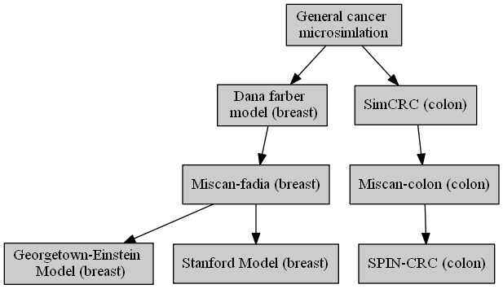
Interconnection graph

Slide 12
Model “inpractice” notes
Unique Model Name (UMN) | Inner citations | Outer citations | Was used in screening? | Number of influenced models | Mainstreamness coefficient | Integral usefullness
Miscan-fadia | 10 | 10 | Yes | 5 | 0.8 | 7.7/10
Miscan-colon | 20 | 30 | Yes | 4 | 0.7 | 7.2/10
CRC-SPIN | 5 | 20 | Yes | 5 | 0.4 | 7.5/10
...

Slide 13
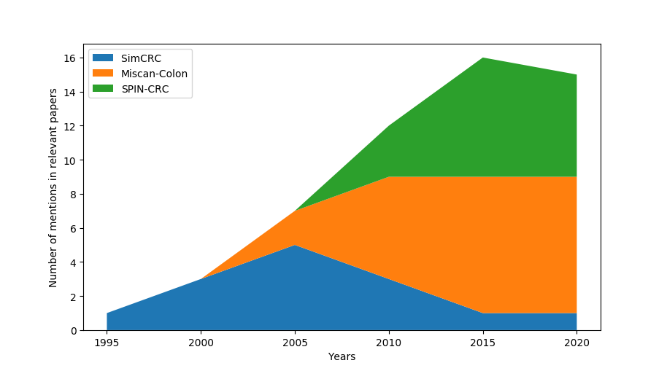
Model usage trend (for colon models)

Slide 14
Inference approach
Forming the criteria of models similarity
Forming a criteria for model trend
Forming criteria for model usefulness
Make systemized data visualizations
Make genetic algorithm that uses gathered data to create simulation of models spreading. Teach it and then make predictions on model trends and demands
Use bootstrap to predict trends confidence intervals

